Slide 1
Space-Time Tree Ensemble for Action Recognition
Shugao Ma, Leonid Sigal*, Stan Sclaroff
Department of Computer Science, Boston University
*Disney Research Pittsburgh

Slide 2
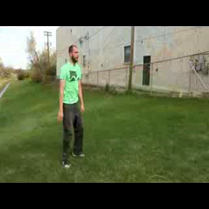
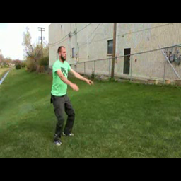
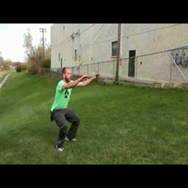
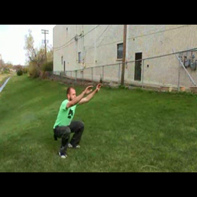
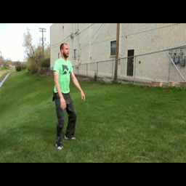
Human Action Recognition in Videos
Squat?
Sit down?
Lifting ?
… …
Squat

Slide 3
Human actions are inherently structured patterns of body movements.

Slide 4
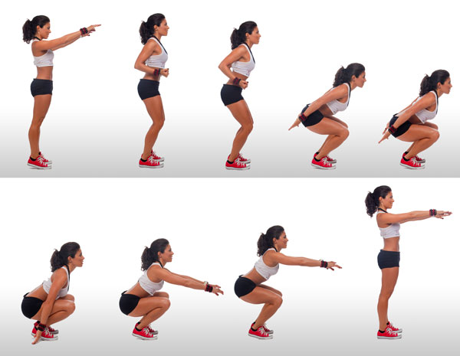
spatial structures
Below
squat
credit of original photo: www.paceliving.com

Slide 5
temporal structures
squat
Before
credit of original photo: www.paceliving.com

Slide 6
hierarchical structures
is-part
is-part
squat
credit of original photo: www.paceliving.com

Slide 7
Algorithms for Action Recognition
 | Space-time structural information | Number of structures | Topology of the structures | Supervision
Bag-of-Words | Discarded | N/A | N/A | action class label of video
E.g. , Laptev et al. CVPR 2008, Wang et al. IJCV 2013, Wang et al. ICCV 2013,
Ma et al. ICCV 2013, Zhang et al. CVPR 2014, Kantorov et al. CVPR 2014

Slide 8
Algorithms for Action Recognition
 | Space-time structural information | Number of structures | Topology of the structures | Supervision
Bag-of-Words | Discarded | N/A | N/A | action class label of video
Space-Time Pyramid | Weakly captured | N/A | N/A | action class label of video
E.g. , Laptev et al. CVPR 2008, Sadanand et al. CVPR 2012, Oneata et al. ICCV 2013

Slide 9
Algorithms for Action Recognition
 | Space-time structural information | Number of structures | Topology of the structures | Supervision
Bag-of-Words | Discarded | N/A | N/A | action class label of video
Space-Time Pyramid | Weakly captured | N/A | N/A | action class label of video
Structural Models (past works) | captured | Predefined, often one | predefined | action class label of video + human bounding box annotations
E.g. , Ramanan et al. NIPS 2003, Weinland et al. ICCV 2007, Ikizler et al. IJCV 2008,
Wang et al. TPAMI 2011, Raptis et al. CVPR 2012, Wang et al. ECCV 2014

Slide 10
Our Approach

Slide 11
Action as Space-Time Trees
Any graph can be approximated by a set of trees.
Inference with trees is efficient and exact.
A collection of trees is necessary for intra-class variations.
Partial matching for trees is allowed in inference.
Root action word
Part action word
Temporal
Relationship
… …
Spatial
Relationship

Slide 12
Space-Time Tree
10
12
20
22
18
24
discriminative node and edge weights
discriminative node and edge weights
tree nodes (indices to action words)
adjacency matrices for time, space and hierarchy
tree nodes (indices to action words)
adjacency matrices for time, space and hierarchy
The tree nodes, the tree edges and their weights are all learned from training data.
Action words are used to share parameters among trees, reducing model complexities.

Slide 13
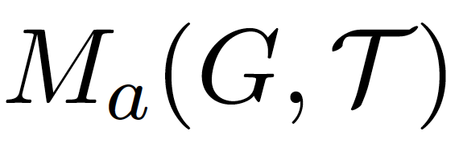
Ensemble of Space-Time Trees
For each action class , a collection of trees is used to construct action classifier . .
video graph
collection of trees
tree matching score
ensemble weight

Slide 14
Algorithms for Action Recognition
 | Space-time structural information | Number of structures | Topology of the structures | Supervision
Bag-of-Words | Discarded | N/A | N/A | action class label of video
Space-Time Pyramid | Weakly captured | N/A | N/A | action class label of video
Structural Models (past works) | captured | Predefined, often one | predefined | action class label of video + human bounding box annotations
Ensemble of Space-Time Trees | Better captured | discovered from training data | discovered from training data | action class label of video

Slide 15
The Algorithm

Slide 16
Learning Action Words
image credit: familysponge.com

Slide 17
Extracting Hierarchical Space-Time Segments (Ma et al. ICCV 2013)
… …
Training
Videos
Root Space-Time Segments
… …
Part Space-Time Segments

Slide 18
Discriminative Clustering
1
2
3
…
… …
Root Action Words
Training
Videos
1
2
… …
3
…
Part Action Words

Slide 19
Affinity Propagation
(Frey et al. Science 2007)
+
+
+
+
+
+
+
+
+
+
+
+
+
+
+
+
+
+
+
+
+
+
+
-
+
+
+
-
-
+
+
-
-
+
-
+
-
-
-
-
-
+
-
+
+
+
+
+
+
+
+
+
+
+
+
+
-
+
-
-
Discriminative Subcategorization
(Hoai et al. CVPR 2013)
-
-
-

Slide 20
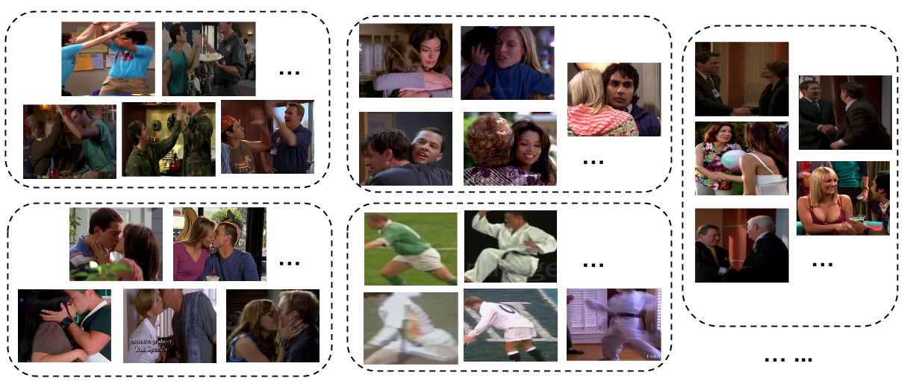
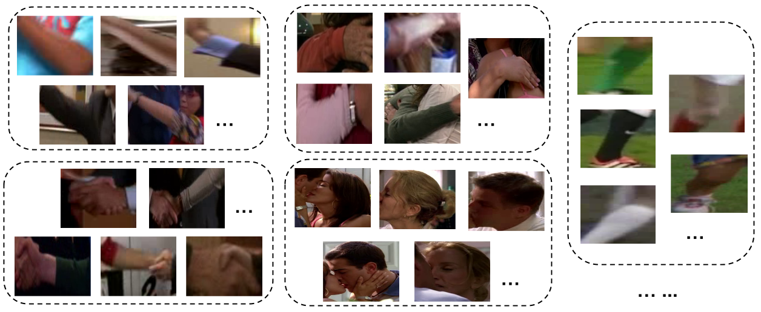
Root Action
Words
Part Action
Words

Slide 21
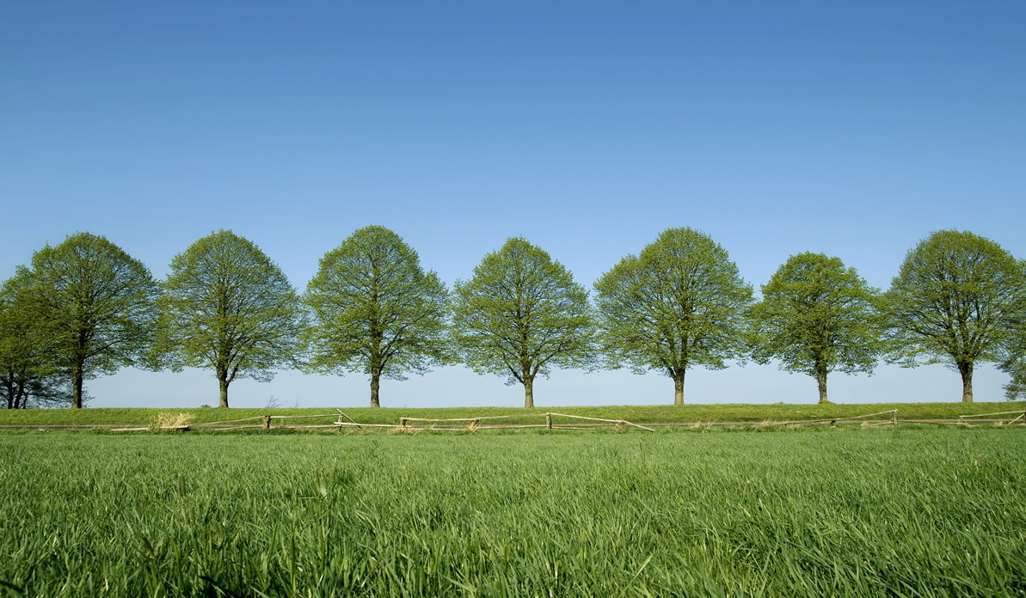
Learning Space-Time Trees
image credit: www.naturalturf.net

Slide 22
Extracting Hierarchical Space-Time Segments
Training Video
…
…
Training Video

Slide 23
Construct Video Graph
Training Video
…
…
Training Video

Slide 24
Associating Action Words to Graph Vertices
8
8
17
Training Video
31
31
25
25
…
…
…
12
10
Training Video
2
7
17
27
23

Slide 25
Tree Structure Discovery
Discovered Tree Structures
8
8
17
10
Training Video
31
31
25
25
27
33
44
…
…
8
17
tree mining,
tree clustering,
tree ranking
12
31
25
25
10
…
Training Video
2
7
17
27
23

Slide 26
Tree Structure Discovery
Discovered Tree Structures
8
8
17
10
Training Video
31
31
25
25
27
33
44
…
…
8
17
tree mining,
tree clustering,
tree ranking
12
31
25
25
10
…
Training Video
2
7
17
27
23

Slide 27
Tree Structure Discovery
Tree Mining
Tree Clustering
Tree Ranking
Training Video Graphs
Tree Structures

Slide 28
Tree Structure Discovery
Tree Mining
Tree Clustering
Tree Ranking
Training Video Graphs
Tree Structures
Find frequent subtrees by graph mining.
Train discriminative edge and node weights for each mined tree by one iteration of latent-svm.

Slide 29
Frequent Subtree Mining
We use GASTON (Nijssen et al. ICCS 2005) to mine frequent subtrees from training graphs.
Trees with at most six nodes are mined.
We use small support threshold to mine thousands of trees per action class.

Slide 30
Tree Structure Discovery
Tree Mining
Tree Clustering
Tree Ranking
Training Video Graphs
Tree Structures
Compute tree similarities by tree matching.
Cluster trees and select one tree per cluster.

Slide 31
Tree Structure Discovery
Tree Mining
Tree Clustering
Tree Ranking
Training Video Graphs
Tree Structures
Rank trees by activation entropy and select trees with small entropies.
Mean Average Precision
Mean Per-class Accuracy
# of trees
# of trees

Slide 32
Inference
The matching score of a tree to a graph is
pooling function
matching scores to tree nodes and edges
set of all (partial) matches
max pooling: find the best match of the tree in the graph by dynamic programming.

Slide 33
Evaluation

Slide 34
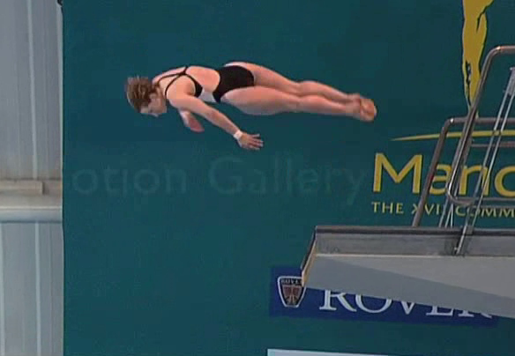
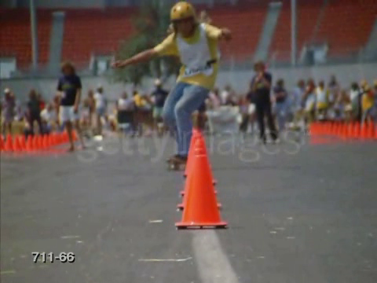
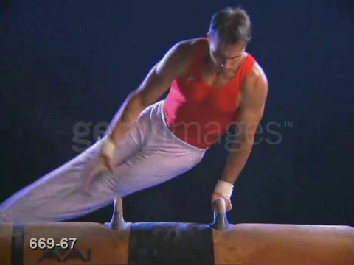
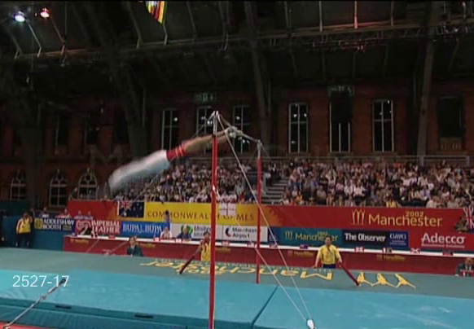
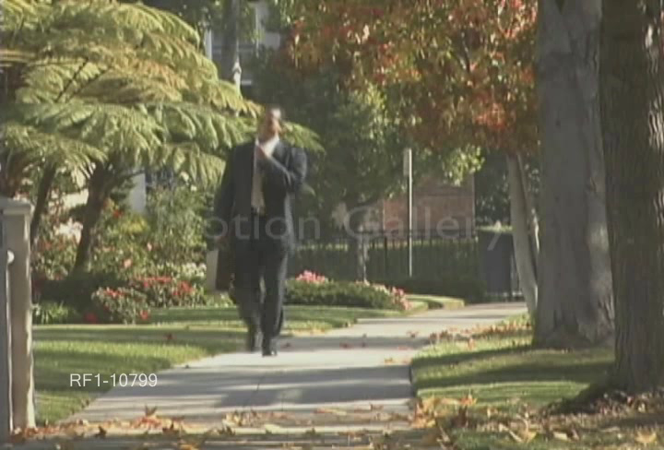
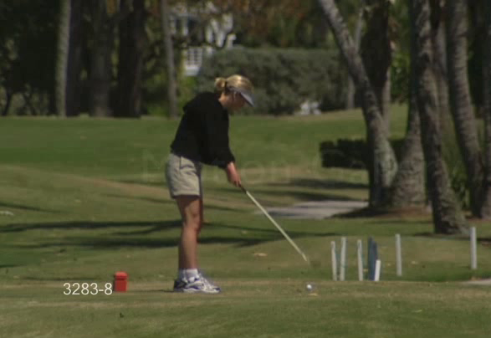
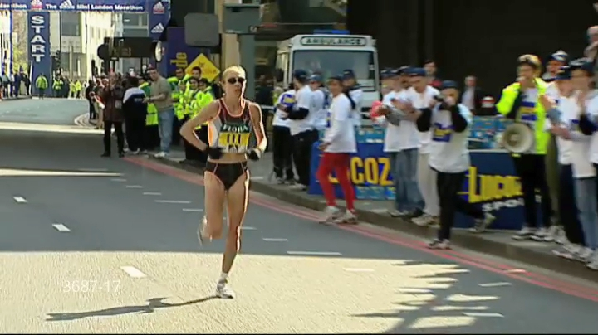
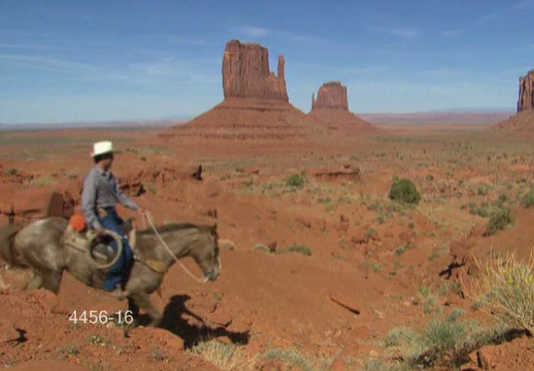
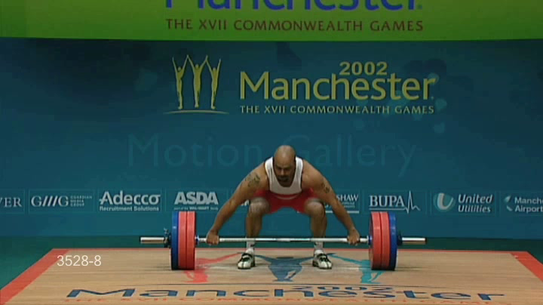
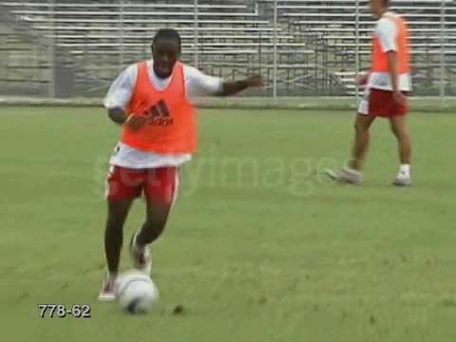
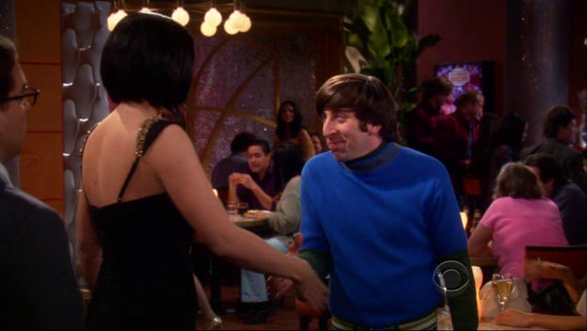
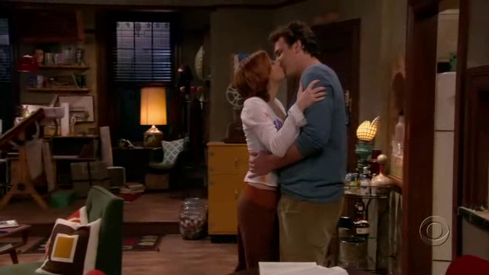
Experiments
UCF-Sports [Rodriguez et al. CVPR 2008]
10 actions, 103 training videos and 47 testing videos
HighFive [Patron-Perez et al. BMVC 2010]
4 interactions from TV programs, 150 training videos and 150 testing videos

Slide 35
Action Classification
HighFive Dataset
UCF-Sports Dataset
Method | mAP
Ours (early fusion) | 62.7
Ours (late fusion) | 64.4
Gaidon et al. IJCV 2014 | 62.4
Wang et al. CVPR 2011 | 53.4
Ma et al. ICCV 2013 | 53.3
Patron-Perez et al. BMVC 2010 | 42.4
Laptev et al. CVPR 2008 | 36.9
Method | Accuracy
Ours (early fusion) | 89.4
Ours (late fusion) | 86.9
Wang et al. ICCV 2013 | 85.2
Ma et al. ICCV 2013 | 81.7
Raptis et al. CVPR 2012 | 79.4
Tian et al. CVPR 2013 | 75.2
Lan et al. ICCV 2011 | 73.1
mAP: mean average precision
Accuracy: mean per-class accuracy

Slide 36
Impact of Tree Size
Tree discriminative power increases as we capture more complex time, space and hierarchical structures.
UCF-Sports
Mean Per-class Accuracy
# of tree nodes = 6
# of tree nodes = 5
# of tree nodes = 4
# of tree nodes = 3
# of tree nodes = 2
# of trees

Slide 37
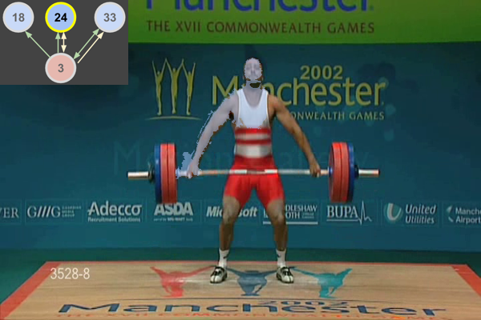

Slide 38
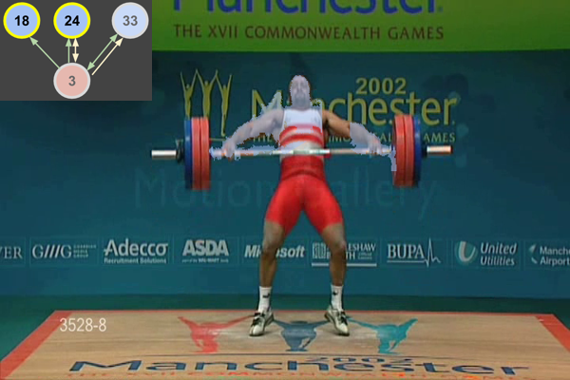

Slide 39
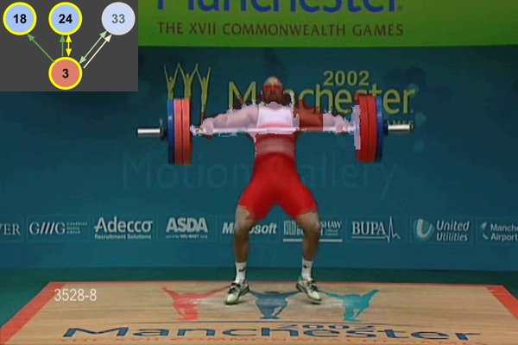

Slide 40
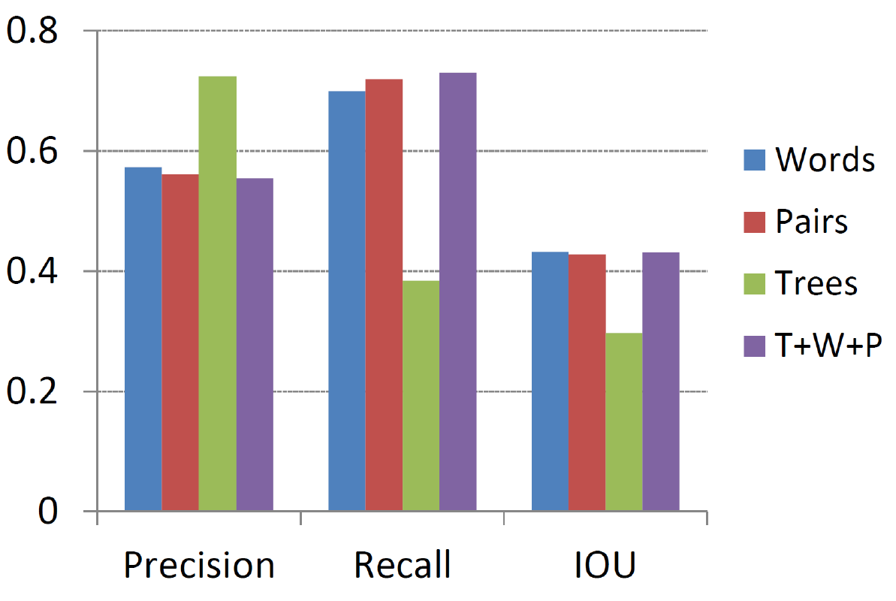
Action Localization
UCF-Sports
Precision predicted area (PA) divided by ground truth area (GA)
Recall intersection of PA and GA divided by GA
IOU intersection of PA and GA divided by union of PA and GA

Slide 41
Cross Dataset Validation
We use trees learned on HighFive to recognize two actions common in the Hollywood3D dataset.
Evaluation Metric: Average Precision
Method | Kiss | Hug
Hadfield et al. CVPR 2013 | 10.2 | 12.1
Ours (not using depth info) | 20.8 | 27.4
Hadfield et al. ECCV 2014 | 31.3 | 32.4

Slide 42
Now you might have the following question:
Can you give me a summary?

Slide 43
Our method automatically discovers space-time trees from training videos that capture rich time, space and hierarchical structures in human actions.
We propose the ensemble of space-time trees for action classification and achieve promising results.
We show generalization of the learned trees by cross-dataset validation.
AND
Please visit our poster (#63, afternoon)!

